Slide 1
Personality: The characteristic ways in which someone thinks, feels and behaves.
Like IQ – not a “thing” which we can directly measure, it is a construct.
Psychologists look to better understand it. Key questions:
What is it? Is it stable? Can it predict behaviour?
Personality traits are the stable, fundamental units of behaviour displayed in any / every situation.
Trait theorists believe there is a level of stability to a persons personality – over time and in different situations, people behave and react in similar patterns.
Trait theories imply a genetic basis to behaviour and personality.
Trait theories are usually measured by quantitative, continuous data – personality can be given a numeric score via psychometric testing

Slide 2


Learning Intention
I will be able to describe what a trait theory of personality is
I will be able to describe the traits that McCrae and Costa (1999) and Ashton and Lee (2005) proposed
I will be able to evaluate trait theories of personality

Slide 3
Personality is an individual’s characteristic pattern of thinking, feeling, and acting/behaving.
Vocabulary
dimension: measurable aspect/feature/characteristic
Concept Development
Checking for understanding
Explain what a personality trait is using an example.
A personality trait is a stable and consistent form of thinking, feeling or behaving that someone displays in any and every situation.

Slide 4
Trait theories of personality
Vocabulary
personality: characteristic ways of thinking, feeling and behaving personality trait: stable/consistent form of thinking, feeling, or behaving dimension: measurable aspect/feature/characteristic
Concept Development
Trait theory focusses on identifying and measuring individual personality traits.
Trait theories suggest that individual personalities are composed (made up of) these general traits. The combination and interaction of various traits form a personality that is unique to each individual.
Checking for understanding
How do trait theories explain personality (generally)?

Slide 5
Trait theories of personality
Vocabulary
personality: characteristic ways of thinking, feeling and behaving personality trait: stable/consistent form of thinking, feeling, or behaving dimension: measurable aspect/feature/characteristic unabridged: complete; full-length
Allport and Odbert (1936) counted all the words in an unabridged dictionary which could describe people. They counted almost 18,000!
To reduce this list to a manageable number of basic traits, researchers identified clusters of related items (this statistical process is called factor analysis).
Example: People who describe themselves as outgoing also tend to say that they like excitement and practical jokes and dislike quiet reading. These corresponding clusters of behaviours reflect a basic factor or trait – extraversion.
Concept Development
Checking for understanding
Explain how researchers have used factor analysis to establish personality traits.

Slide 6
Trait theories of personality: Eysenck & Eysenck [‘Eye-zinc’]
Vocabulary
personality: characteristic ways of thinking, feeling and behaving personality trait: stable/consistent form of thinking, feeling, or behaving dimension: measurable aspect/feature/characteristic
British psychologists Hans Eysenck and Sybil Eysenck (1963) believed that we can reduce many of our normal individual variations to two or three dimensions:
Extraversion – Introversion (degree of sociability)
Neuroticism (emotional instability) – Emotional Stability (degree of emotionality)
Psychoticism* (degree to which reality is distorted) (Later (in the 1970s), after studying individuals suffering from mental illness, Eysenck added a personality dimension he called psychoticism to his trait theory. Individuals who are high on this trait tend to have difficulty dealing with reality and may be antisocial, hostile, non-empathetic, and manipulative).
Eysenck said we all have traits within these categories, but we express them to varying degrees (to different extents).
Concept Development
Checking for understanding
How did the Eysnecks explain personality?

Slide 7
Support for Trait theories of personality:
Eysenck & Eysenck [‘Eye-zinc’]
Vocabulary
personality: characteristic ways of thinking, feeling and behaving personality trait: stable/consistent form of thinking, feeling, or behaving dimension: measurable aspect/feature/characteristic
Concept Development
The Eysnecks believed that these factors are genetically influenced, and research supports this belief:
Brain-activity scans of extraverts indicate that extraverts seek stimulation because their normal brain arousal is relatively low. PET scans show that at frontal lobe area involved in bahaviour inhibition is less active in extraverts than in introverts (Johnson et al., 1999)
Our personality can also be influenced by our genes. For example, Jerome Kagan (1987) has attributed differences in children’s shyness and inhibition to their autonomic nervous system reactivity.
Checking for understanding
What did the results of Eysneck’s research in the 1990s suggest about the personality dimensions of extraversion and emotionality? Describe the evidence that supports the Eysnecks’ claim that personality is biological/genetic.

Slide 8
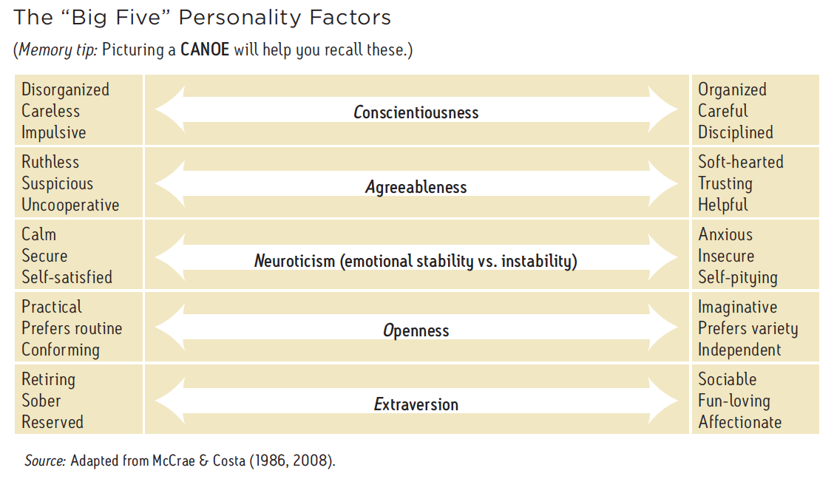
Trait theories of personality: McCrae and Costa
[“Big Five” or “OCEAN” personality traits]
Vocabulary
personality: characteristic ways of thinking, feeling and behaving personality trait: stable/consistent form of thinking, feeling, or behaving dimension: measurable aspect/feature/characteristic
There has been growing research and evidence to support the theory that there are FIVE dimensions of personality (D.W Fiske (1949); Norman (1967); Smith (1967); Goldberg (1981); McCrae and Costa (1987))
The ‘Big Five’ or ‘OCEAN’ factors of personality is well supported by research (Heine & Buchtel, 2009; McCrae, 2009; Funder, 2001).
Around the world – across 56 nations and 29 languages (Schmitt et al., 2007) – people described others in terms roughly consistent with the Big Five factors.
Concept Development
Checking for understanding
Using the Big Five model, describe someone who is high on conscientiousness and agreeableness, and low on neuroticism, openness and extraversion. Where do you place yourself on each of the dimensions?

Slide 9
Trait theories of personality: McCrae and Costa
[“Big Five” or “OCEAN” personality traits]
Vocabulary
personality: characteristic ways of thinking, feeling and behaving personality trait: stable/consistent form of thinking, feeling, or behaving dimension: measurable aspect/feature/characteristic
Concept Development
Checking for understanding
Name three traits from McCrae and Costa’s personality theory. For each, list one characteristic that a person who is high in that trait might have.

Slide 10
Trait theories of personality: McCrae and Costa
[“Big Five” or “OCEAN” personality traits]
Vocabulary
personality: characteristic ways of thinking, feeling and behaving personality trait: stable/consistent form of thinking, feeling, or behaving dimension: measurable aspect/feature/characteristic
The school principal requested a Year 12 student to present a talk to Year 7 students on study tips for high school. Raphael volunteered to do the talk. Describe how trait theory would explain why Raphael volunteered.
(Identify a trait dimension and where R would be placed on it; Link it to the scenario; cite the relevant research)
Concept Development
Trait theorists would explain that Raphael’s personality sits high on the ‘agreeableness’ trait dimension as he was being helpful, and high on the ‘conscientiousness’ dimension as he would have to be organised to have good study tips (Costa and McCrae, 1987)

Slide 11
Trait theories of personality: McCrae and Costa
[“Big Five” or “OCEAN” personality traits]
Rin is a Year 7 student who is causing concern at his school. He does not interact with other students in group work, he never answers questions in class and spends lunch and recess on his own. When other students approach him, he avoids eye contact and folds his arms in front of him. Teachers have spoken to him about his behaviour but he considers himself friendly and does not see a need to change.
Rin has also demonstrated another unusual behaviour. At his school, it is common practice for students to bring in cupcakes once a month to share with other children. The cupcakes are placed at the front of the class and students are required to wait until recess to receive their cupcake. However, Rin consistently runs to the front of the room as soon as the cupcakes are placed and takes one back to his desk. This has caused many of the students to complain about his behaviour.
Concept Development
Checking for understanding
Explain Rin’s behaviour with reference to McCrae and Costa’s trait theory.

Slide 12
Ashton & Lee (2005)
More recently A&L added a 6th factor (honesty - humility) to the Big 5
Both the Big 5 / HEXACO model try to explain and predict behavior.
Both have been widely used used in the recruitment process and when examining workplace behaviour.
e.g. Jia, Jia and Karau (2013)
Examined whether there’s a correlation between Big 5 traits, perceived meaning in a persons work and their level of cyberloafing.
Results –
Extraversion = significant pos. correlation to cyberloafing
Conscientiousness / emo stability = neg. correlation with cyberloafing

Slide 13

Task!
Part 1:
Rate a partner at the table from 1 – 5 (1 being the lowest, 3 average, 5 high)
On each of the HEXACO traits – write it down. DON’T SHOW YOUR PARTNER
Part 2:
Go and take the Hexaco personality test
Be honest, Be thoughtful, it should take around 7 minutes
DON’T talk – it may interfere with other peoples results
http://hexaco.org/hexaco-online

Slide 14
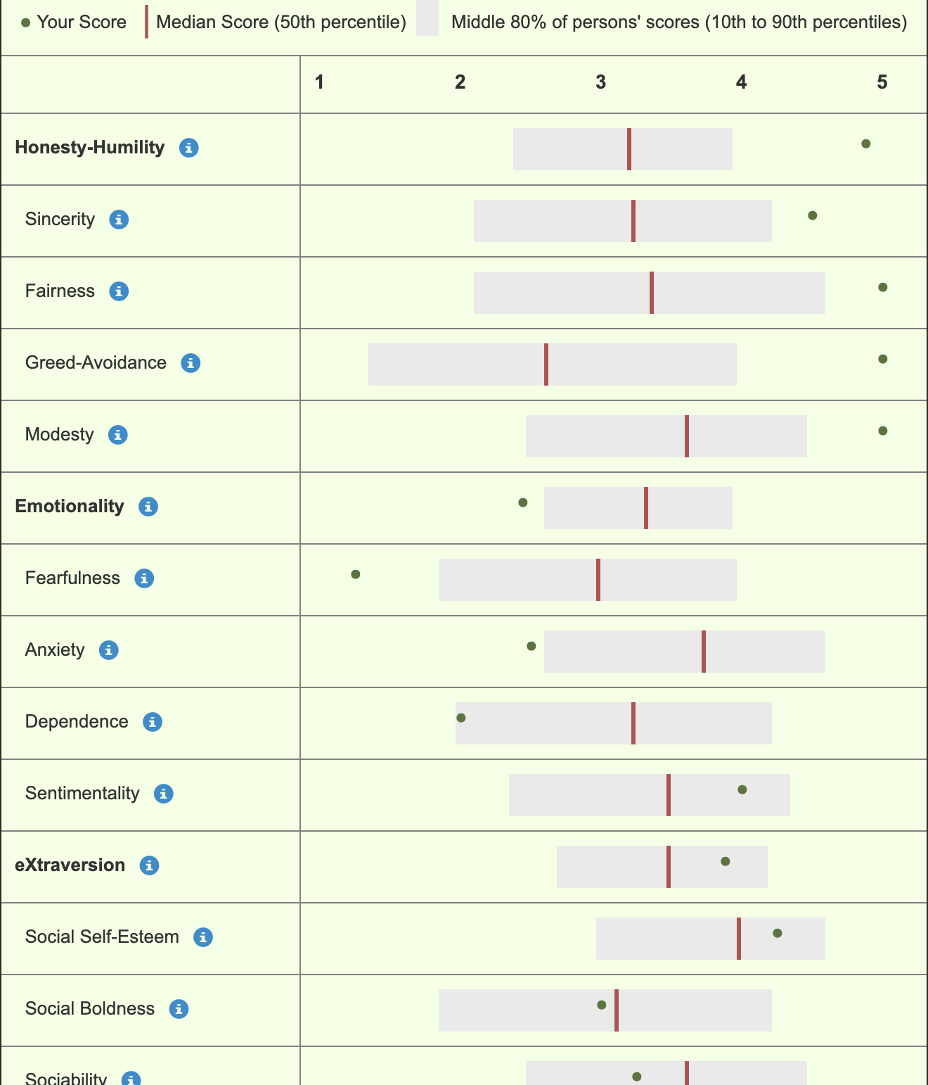
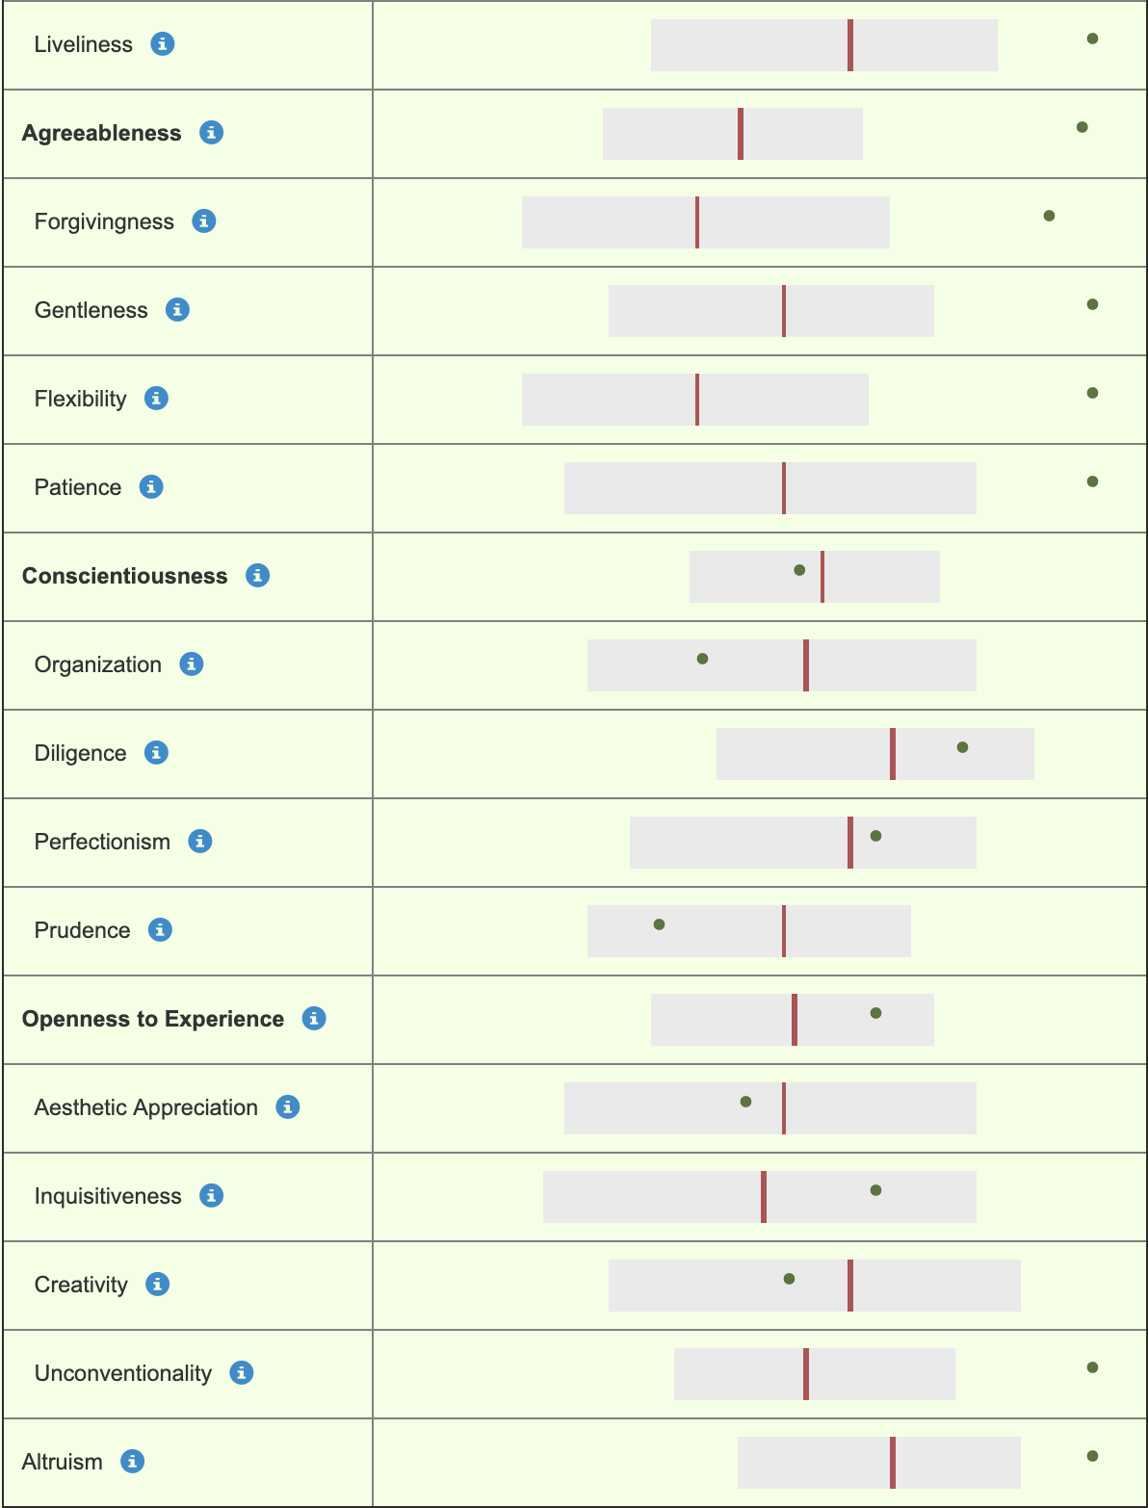
Ms. Davey’s HEXACO results

Slide 15
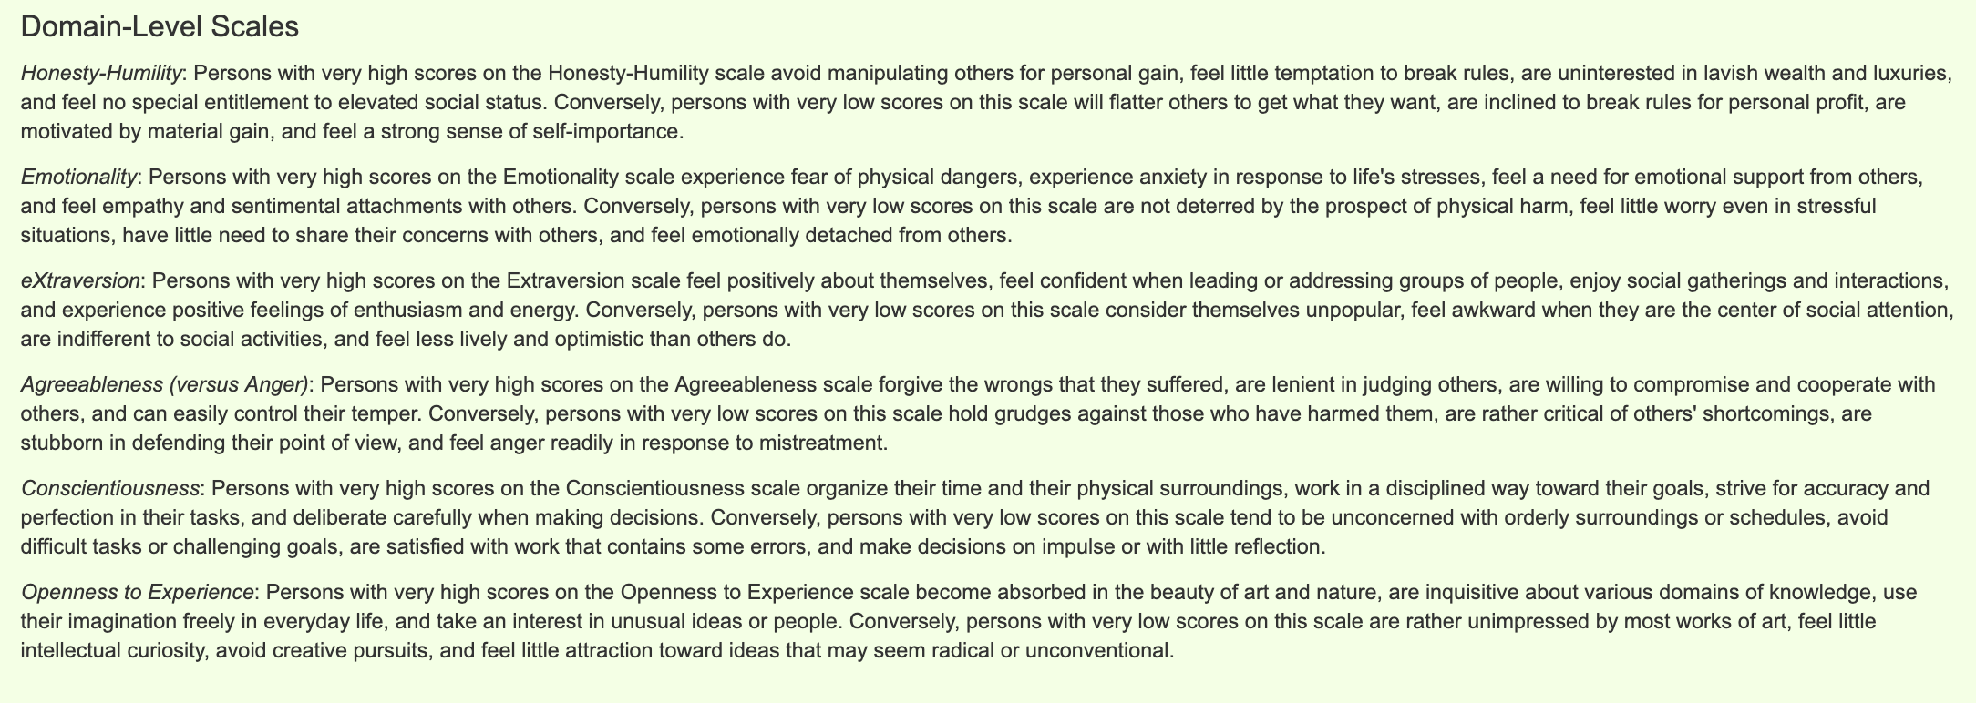
Interpret your results
More detail…
http://hexaco.org/scaledescriptions

Slide 16
DO YOU AGREE WITH YOUR RESULTS?
Research methods link:
Are the results objective or subjective? Are your results reliable / valid? – why / why not?

Slide 17
TASK:
Choose a different partner you work well with
Stand opposite them
Wait for further instructions
Honesty / Humility – manipulative
Emotionality – from neuroticism to emotionally stable
Extraversion – Introversion
Agreeableness – Aloofness
Conscientiousness - Careless
Openness to experience – Closed to experience

Slide 18
Steps to evaluate trait theories of personality
Vocabulary
personality trait: stable/consistent form of thinking, feeling, or behaving evaluate: carefully assess the value of something
A claim of all trait theories is that personality traits are stable, enduring characteristics. If there is continuity in personality over time, each of us should be basically the same persona that we were 3 or 4 years ago, and we should still be basically the same person in 5, 10 or 15 years’ time.
When evaluating trait theories of personality we assess whether this claim holds value by considering research that supports or rejects this claim. We need to ask:
Does research support the consistency
of personality traits over time and across
situations?
Skill Development/Guided Practice
Checking for understanding
What does it mean to evaluate something? What are we assessing the value of when evaluating trait theories of personality

Slide 19
Steps to evaluate trait theories of personality
Vocabulary
personality trait: stable/consistent form of thinking, feeling, or behaving evaluate: carefully assess the value of something
Does research support the consistency of personality traits over time and across
situations?
Scan then read pages 102-105 of your textbook, and pages 533 – 537 of the additional reading provided.
Identify research that investigates/comments on the stability of personality traits
Describe the research (including the method if available) and its results
Explain whether (and to what extent) the research supports or rejects the consistency of personality traits
Form an evaluation (conclusion) from your analysis of the research
Skill Development/Guided Practice
Details of research | Description of research | Results support the consistency of personality traits across time and situations | Results reject the consistency of personality traits across time and situations
Checking for understanding
Describe the approach we will employ to evaluate trait theories of personality. What is the value of scanning a text before reading it closely.

Slide 20
Evaluate trait theories of personality
Vocabulary
personality trait: stable/consistent form of thinking, feeling, or behaving evaluate: carefully assess the value of something
Does research support the consistency of personality traits over time and across
situations?
Skill Development/Guided Practice
STEPS:
Scan then read pages 102-105 of your textbook, and pages 533 – 537 of the additional reading provided.
Identify research that investigates/comments on the stability of personality traits
Describe the research (including the method if available) and its results
Explain whether (and to what extent) the research supports or rejects the consistency of personality traits
Details of research | Description of research | Results support the consistency of personality traits across time and situations | Results reject the consistency of personality traits across time and situations

Slide 21
Evaluate trait theories of personality
Vocabulary
personality trait: stable/consistent form of thinking, feeling, or behaving evaluate: carefully assess the value of something
Does research support the consistency of personality traits over time and across
situations?
Skill Development/Guided Practice
STEPS:
Scan then read pages 102-105 of your textbook, and pages 533 – 537 of the additional reading provided.
Identify research that investigates/comments on the stability of personality traits
Describe the research (including the method if available) and its results
Explain whether (and to what extent) the research supports or rejects the consistency of personality traits
Details of research | Description of research | Results support the consistency of personality traits across time and situations | Results reject the consistency of personality traits across time and situations

Slide 22
Evaluate trait theories of personality
Vocabulary
personality trait: stable/consistent form of thinking, feeling, or behaving evaluate: carefully assess the value of something
Does research support the consistency of personality traits over time and across
situations?
Skill Development/Guided Practice
STEPS:
Scan then read pages 102-105 of your textbook
Identify research that investigates/comments on the stability of personality traits
Describe the research (including the method if available) and its results
Explain whether (and to what extent) the research supports or rejects the consistency of personality traits
Details of research | Description of research | Results support the consistency of personality traits across time and situations | Results reject the consistency of personality traits across time and situations

Slide 23
Evaluate trait theories of personality
Vocabulary
personality trait: stable/consistent form of thinking, feeling, or behaving evaluate: carefully assess the value of something
Does research support the consistency of personality traits over time and across
situations?
STEPS:
Scan then read pages 102-105 of your textbook, and pages 533 – 537 of the additional reading provided.
Identify research that investigates/comments on the stability of personality traits
Describe the research (including the method if available) and its results
Explain whether (and to what extent) the research supports or rejects the consistency of personality traits
Form an evaluation (conclusion) informed by your analysis of the reading.
Skill Development/Guided Practice
Details of research | Description of research | Results support the consistency of personality traits across time and situations | Results reject the consistency of personality traits across time and situations

Slide 24
Evaluate trait theories of personality
Vocabulary
personality trait: stable/consistent form of thinking, feeling, or behaving evaluate: carefully assess the value of something
Does research support the consistency of personality traits over time and across
situations?
Analyse this section of page 103 in pairs:
Skill Development/Guided Practice
STEPS:
Scan then read pages 102-105 of your textbook, and pages 533 – 537 of the additional reading provided.
Identify research that investigates/comments on the stability of personality traits
Describe the research (including the method if available) and its results
Explain whether (and to what extent) the research supports or rejects the consistency of personality traits

Slide 25
Evaluate trait theories of personality
Vocabulary
personality trait: stable/consistent form of thinking, feeling, or behaving evaluate: carefully assess the value of something
Does research support the consistency of personality traits over time and across
situations?
Details of research | Description of research | Results support the consistency of personality traits across time and situations | Results reject the consistency of personality traits across time and situations
STEPS:
Scan then read pages 102-105 of your textbook, and pages 533 – 537 of the additional reading provided.
Identify research that investigates/comments on the stability of personality traits
Describe the research (including the method if available) and its results
Explain whether (and to what extent) the research supports or rejects the consistency of personality traits
Form an evaluation (conclusion) informed by your analysis of the reading.
Skill Development/Guided Practice

Slide 26
TASKS:
Complete your analysis of research on the stability of personality traits.
Complete the extended answer question below, referring to the psychological evidence you have analysed
Extended answer question:
Rin is a Year 7 student who is causing concern at his school. He does not interact with other students in group work, he never answers questions in class and spends lunch and recess on his own. When other students approach him, he avoids eye contact and folds his arms in front of him. Teachers have spoken to him about his behaviour but he considers himself friendly and does not see a need to change.
Rin has also demonstrated another unusual behaviour. At his school, it is common practice for students to bring in cupcakes once a month to share with other children. The cupcakes are placed at the front of the class and students are required to wait until recess to receive their cupcake. However, Rin consistently runs to the front of the room as soon as the cupcakes are placed and takes one back to his desk. This has caused many of the students to complain about his behaviour.
Apply your knowledge of trait theories of personality to explain Rin’s behaviour.
In your answer, you should:
identify and define the theory
describe the features of the theory of personality and discuss how these features would explain Rin’s behaviour
Evaluate the theory
Refer to psychological evidence and understandings.
Independent Practice

Slide 27
Why is it relevant to be able to identify and explain techniques for resolving conflicts?
Curriculum links:
Personality Features and limitations of trait theories (McCrae and Costa; Eysenck)
Personality is part of the Year 12 ATAR Syllabus and will help us do well our assessments and exams.
Short answer questions
Extended answer questions
Apply your knowledge of theories of personality to behaviour.
In your answer, you should:
identify and define the key theories
describe the features of each theory of personality and discuss how these features would explain behaviour
Evaluate each theory
Refer to psychological evidence and understandings.
Understanding theories of personality will increase your self-awareness and understanding of others.
Being able to evaluate a theory or idea is an important skill relevant to school and university achievement, and to most careers.
Why is it relevant to you?
Relevance

Slide 28
From your analysis of the research so far, do you agree that personality traits are consistent over time and situations?
Refer to a piece of research to support your conclusion
Closure

